Slide 1
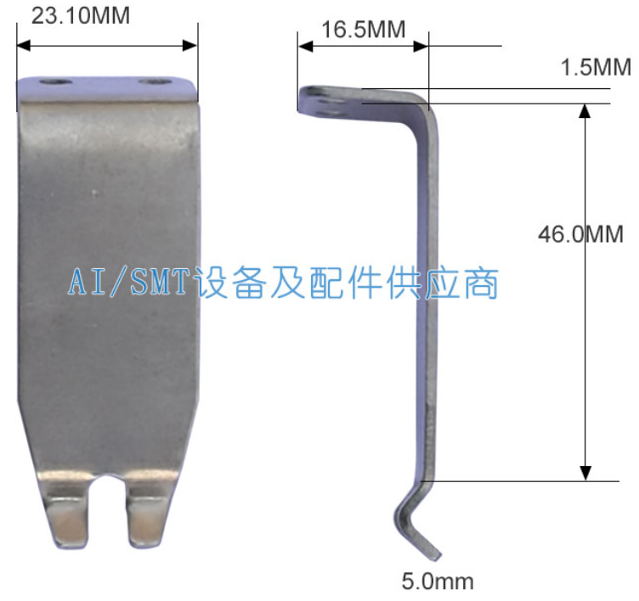
Wave Soldering Machine Finger – Soltec V

Slide 2
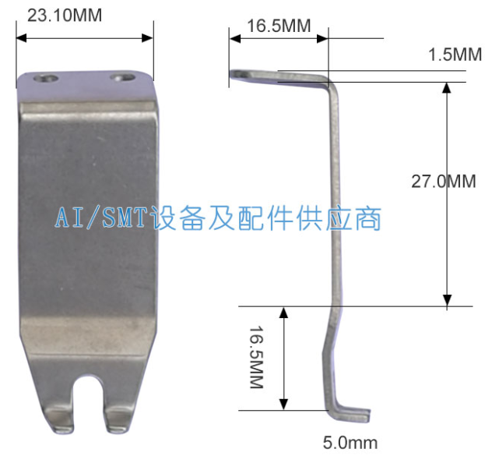
Wave Soldering Machine Finger – Soltec L

Slide 3
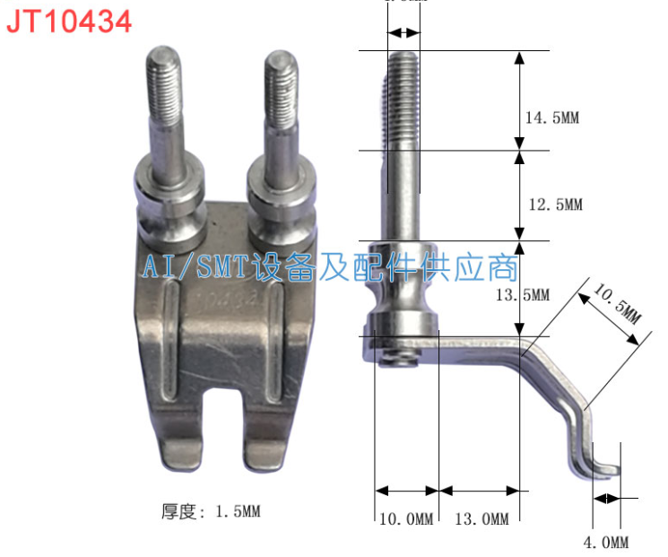
Wave Soldering Machine Finger – JT10434 A
4.9mm

Slide 4
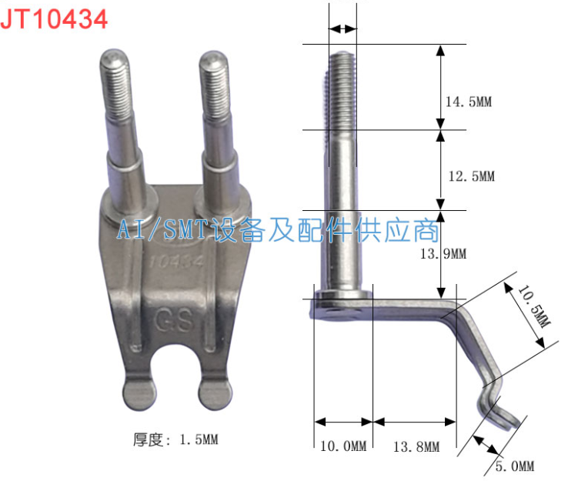
Wave Soldering Machine Finger – JT10434 B
4.9mm

Slide 5
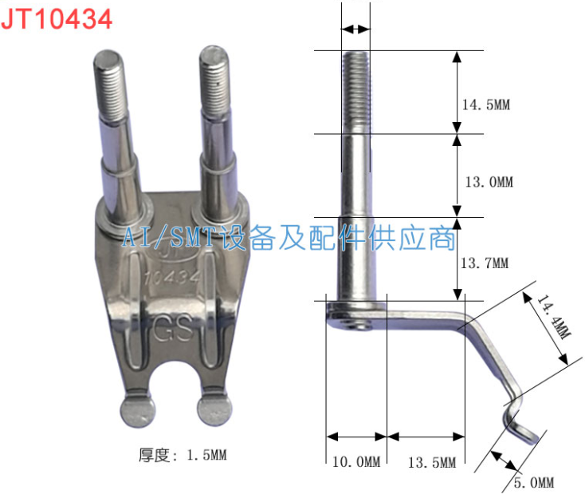
Wave Soldering Machine Finger – JT10434 C
4.9mm

Slide 6
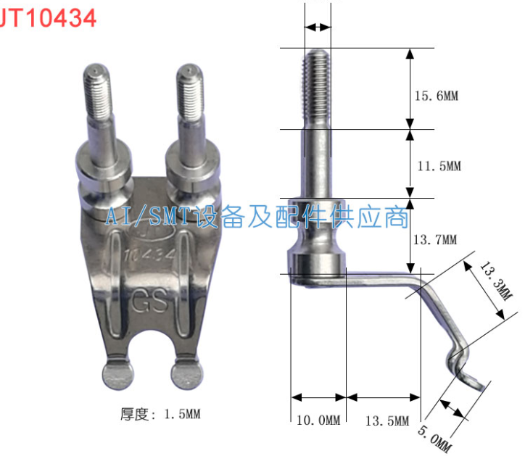
Wave Soldering Machine Finger – JT10434 D
4.9mm

Slide 7
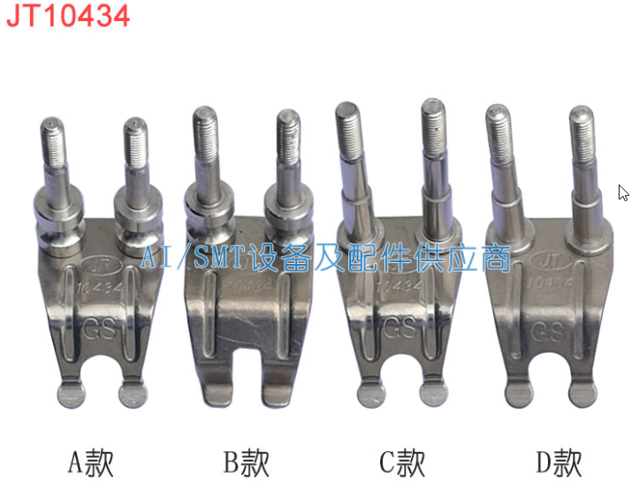
Wave Soldering Machine Finger – JT10434 A/B/C/D

Slide 8
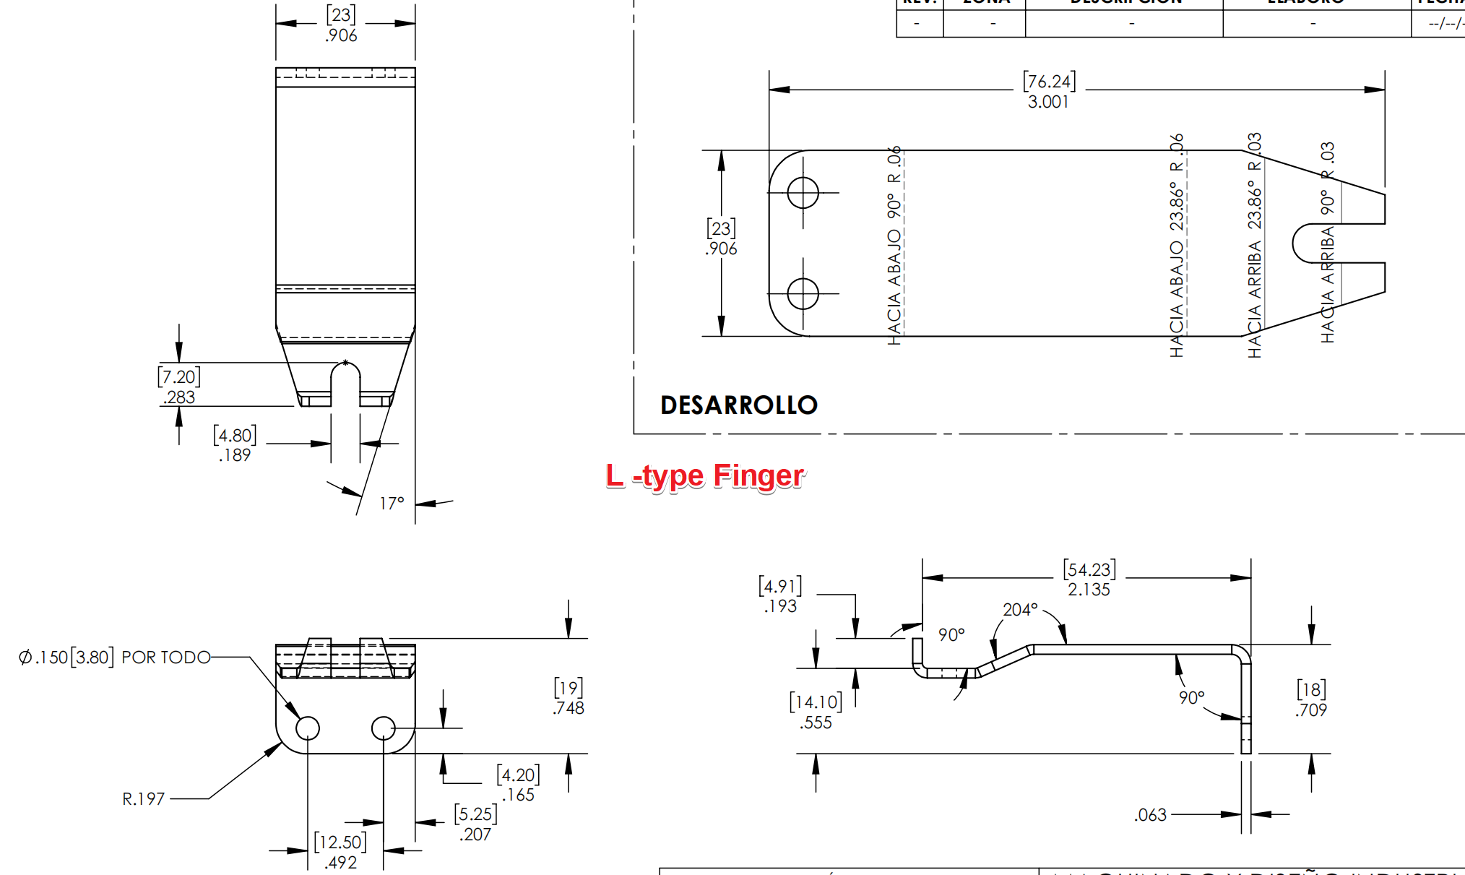
Wave Soldering Machine Finger – L-type

Slide 9
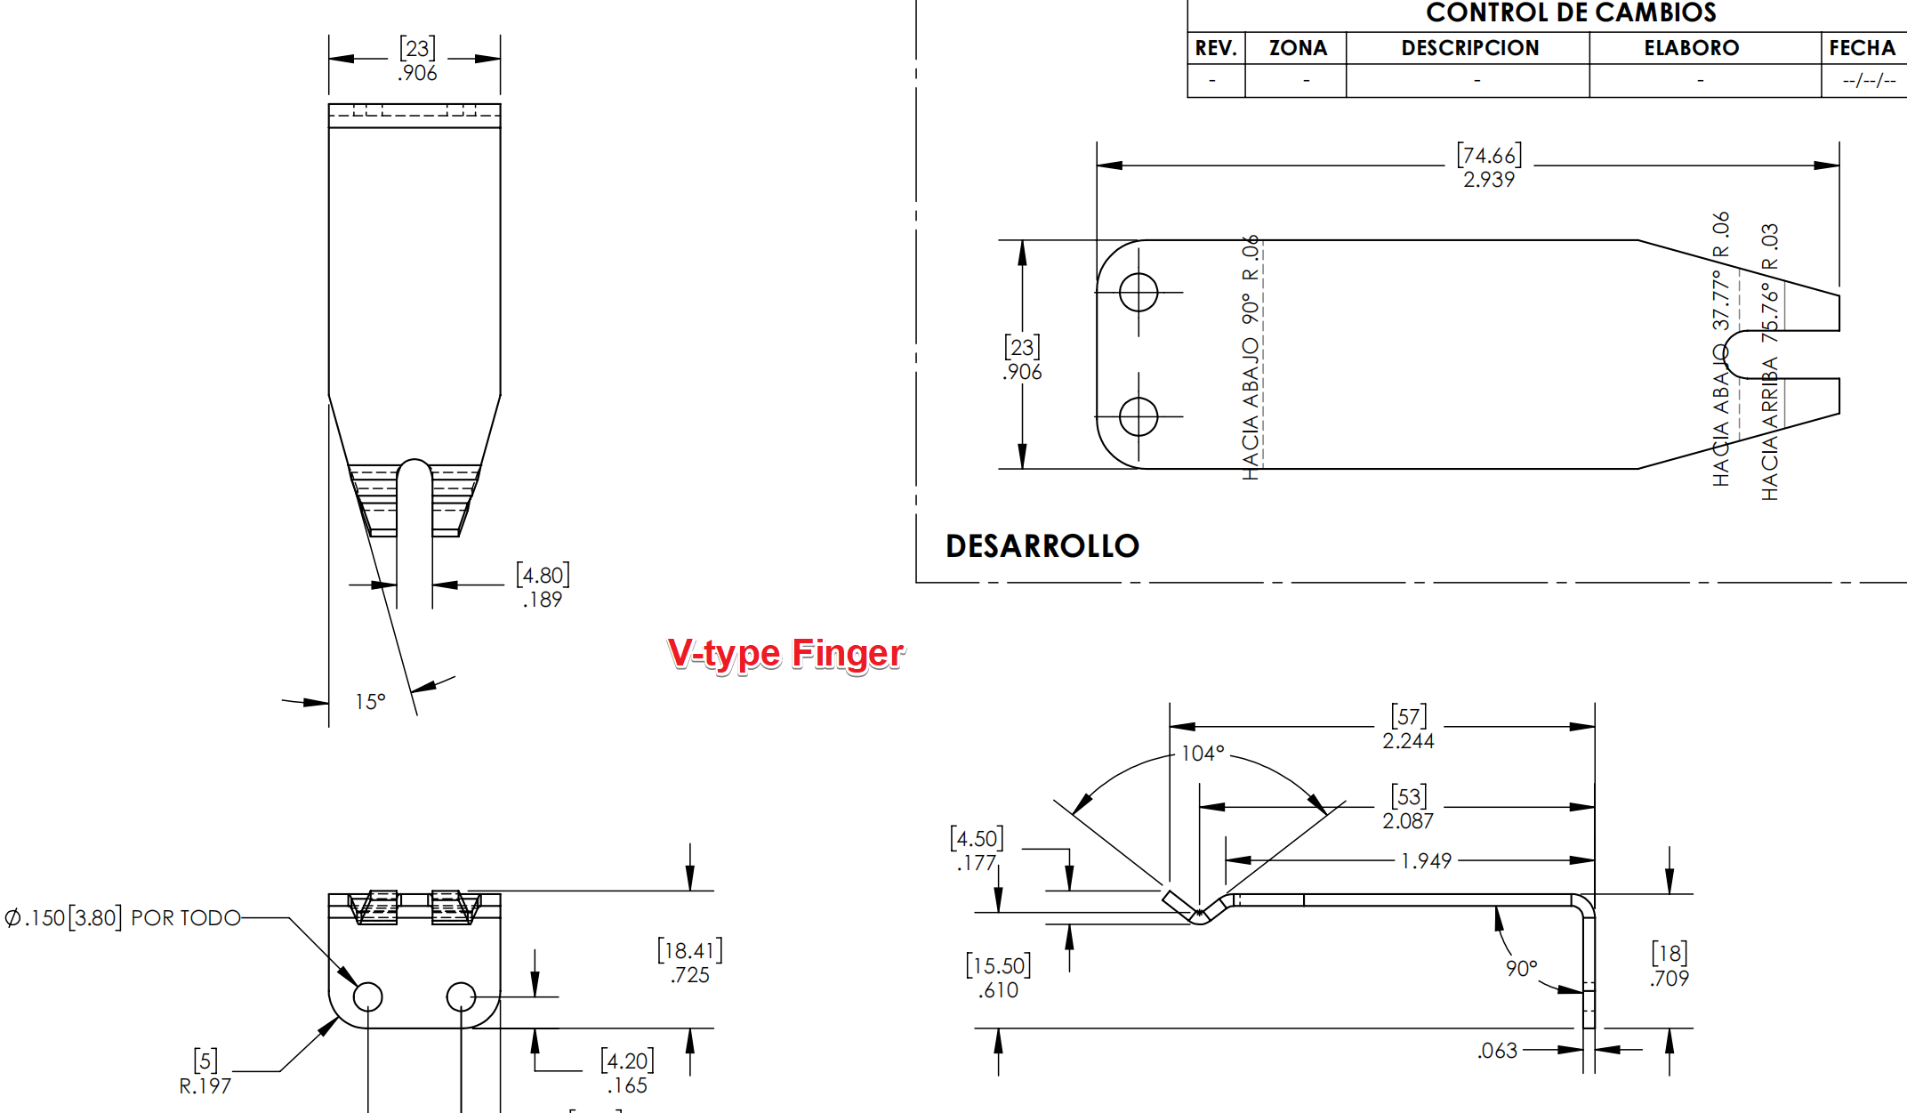
Wave Soldering Machine Finger – V-type

Slide 10
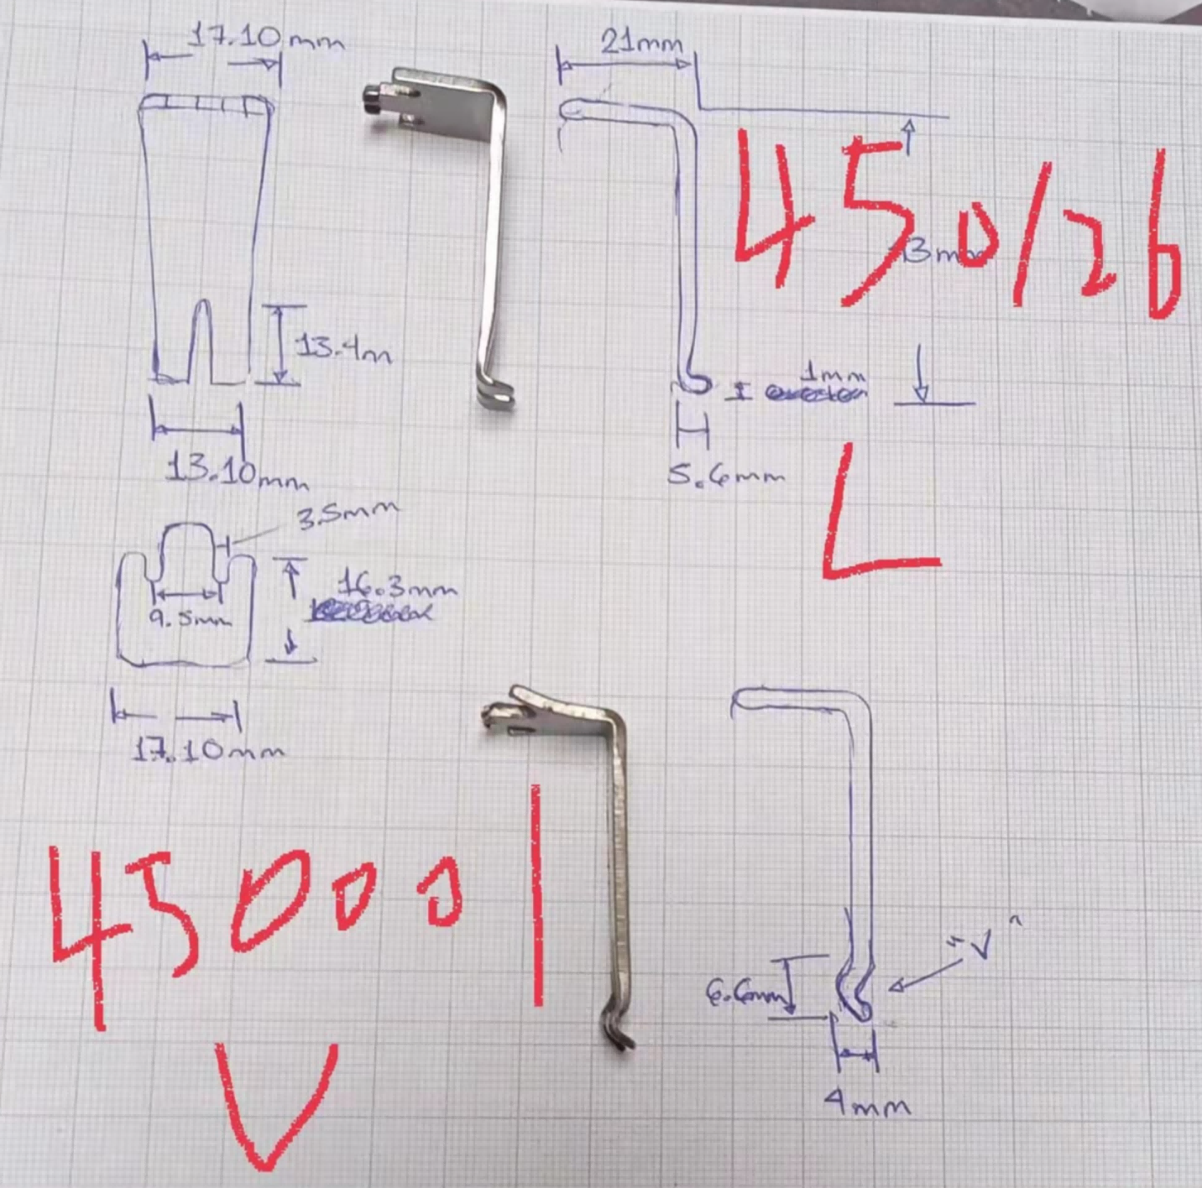
Wave Soldering Machine Finger

Slide 11
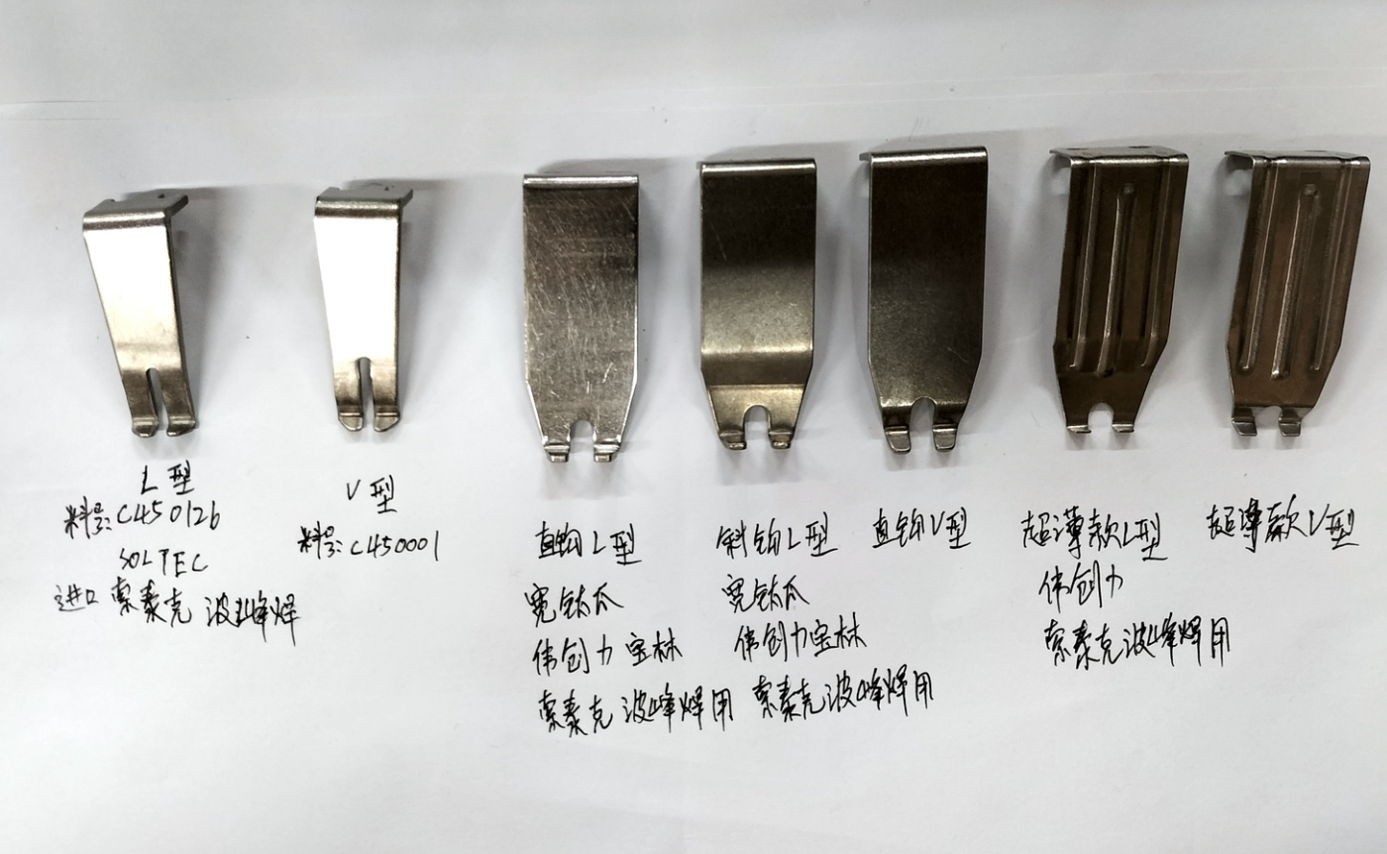
Wave Soldering Machine Finger

Slide 12
WELCOME INQUIRY
Please visit
www.smthelp.com
Find us more
https://www.facebook.com/autoinsertion
Know more our team
https://cn.linkedin.com/in/smtsupplier
Welcome to our factory in Shenzhen China
See more machine working video, please Youtube
Auto Insertion
Google
Auto+insertion, to get more information
Looking forward to your email
info@smthelp.com

